Slide 1

CSD 3102-ARTIFICIAL INTELLIGENCE TECHNIQUES
•
MODULE 3
Universal Instantiation- Existential Instantiation - Unification and Lifting - Resolution

Slide 2
MODULE III KNOWLEDGE AND REASONING 9
Knowledge Representation-Knowledge based Agents-The Wumpus World Logic-Propositional Logic-Predicate Logic-Unification and Lifting - Representing Knowledge using Rules-Semantic Networks Frame Systems Inference – Types of Reasoning.

Slide 3
Universal instantiation (UI)
Every instantiation of a universally quantified sentence is entailed by it:
∀v α
Subst({v/g}, α)
for any variable v and ground term g (Subst(x,y) = substitution of y by x)
E.g., ∀x King(x) ∧ Greedy(x) ⇒ Evil(x) yields:
King(John) ∧ Greedy(John) ⇒ Evil(John)
King(Richard) ∧ Greedy(Richard) ⇒ Evil(Richard)
King(Father(John)) ∧ Greedy(Father(John)) ⇒ Evil(Father(John))
.
.
.
Notes:
‹#›

Slide 4
Existential instantiation (EI)
For any sentence α, variable v, and constant symbol k that does not appear elsewhere in the knowledge base:
∃v α
Subst({v/k}, α)
E.g., ∃x Crown(x) ∧ OnHead(x,John) yields:
Crown(C₁) ∧ OnHead(C₁,John)
provided C₁ is a new constant symbol, called a Skolem constant
Notes:
‹#›

Slide 5
EI versus UI
UI can be applied several times to add new sentences; the new KB is logically equivalent to the old.
EI can be applied once to replace the existential sentence; the new KB is not equivalent to the old but is satisfiable if the old KB was satisfiable.
Notes:
‹#›

Slide 6
Reduction to propositional inference
Suppose the KB contains just the following:
∀x King(x) ∧ Greedy(x) ⇒ Evil(x)
King(John)
Greedy(John)
Brother(Richard,John)
Instantiating the universal sentence in all possible ways, we have:
King(John) ∧ Greedy(John) ⇒ Evil(John)
King(Richard) ∧ Greedy(Richard) ⇒ Evil(Richard)
King(John)
Greedy(John)
Brother(Richard,John)
The new KB is propositionalized: proposition symbols are
John, Richard and also King(John), Greedy(John), Evil(John), King(Richard), etc.
Notes:
‹#›

Slide 7
Reduction contd.
CLAIM: A ground sentence is entailed by a new KB iff entailed by the original KB.
CLAIM: Every FOL KB can be propositionalized so as to preserve entailment
IDEA: propositionalize KB and query, apply resolution, return result
PROBLEM: with function symbols, there are infinitely many ground terms,
e.g., Father(Father(Father(John)))
Notes:
‹#›

Slide 8
Problems with propositionalization
Propositionalization seems to generate lots of irrelevant sentences.
E.g., from:
∀x King(x) ∧ Greedy(x) ⇒ Evil(x)
King(John)
∀y Greedy(y)
Brother(Richard,John)
It seems obvious that Evil(John), but propositionalization produces lots of facts such as Greedy(Richard) that are irrelevant.
With p k-ary predicates and n constants, there are p·n^{k} instantiations!
Notes:
‹#›

Slide 9
Lifting and Unification
Instead of translating the knowledge base to PL, we can redefine the inference rules into FOL.
Lifting; they only make those substitutions that are required to allow particular inferences to proceed.
E.g. generalised Modus Ponens
To intriduce substitutions different logical expressions have to be look identical
Unification
Notes:
‹#›

Slide 10
Unification
We can get the inference immediately if we can find a substitution α such that King(x) and Greedy(x) match King(John) and Greedy(y)
α = {x/John,y/John} works
Unify(α ,β) = θ if αθ = βθ
p q θ
Knows(John,x) Knows(John,Jane)
Knows(John,x) Knows(y,OJ)
Knows(John,x) Knows(y,Mother(y))
Knows(John,x) Knows(x,OJ)
Standardizing apart eliminates overlap of variables, e.g., Knows(z₁₇,OJ)
Notes:
‹#›

Slide 11
Unification
We can get the inference immediately if we can find a substitution α such that King(x) and Greedy(x) match King(John) and Greedy(y)
α = {x/John,y/John} works
Unify(α ,β) = θ if αθ = βθ
p q θ
Knows(John,x) Knows(John,Jane) {x/Jane}
Knows(John,x) Knows(y,OJ)
Knows(John,x) Knows(y,Mother(y))
Knows(John,x) Knows(x,OJ)
Standardizing apart eliminates overlap of variables, e.g., Knows(z₁₇,OJ)
Notes:
‹#›

Slide 12
Unification
We can get the inference immediately if we can find a substitution α such that King(x) and Greedy(x) match King(John) and Greedy(y)
α = {x/John,y/John} works
Unify(α ,β) = θ if αθ = βθ
p q θ
Knows(John,x) Knows(John,Jane) {x/Jane}
Knows(John,x) Knows(y,OJ) {x/OJ,y/John}
Knows(John,x) Knows(y,Mother(y))
Knows(John,x) Knows(x,OJ)
Standardizing apart eliminates overlap of variables, e.g., Knows(z₁₇,OJ)
Notes:
‹#›

Slide 13
Unification
We can get the inference immediately if we can find a substitution α such that King(x) and Greedy(x) match King(John) and Greedy(y)
α = {x/John,y/John} works
Unify(α ,β) = θ if αθ = βθ
p q θ
Knows(John,x) Knows(John,Jane) {x/Jane}
Knows(John,x) Knows(y,OJ) {x/OJ,y/John}
Knows(John,x) Knows(y,Mother(y)) {y/John,x/Mother(John)}}
Knows(John,x) Knows(x,OJ)
Standardizing apart eliminates overlap of variables, e.g., Knows(z₁₇,OJ)
Notes:
‹#›

Slide 14
Unification
We can get the inference immediately if we can find a substitution α such that King(x) and Greedy(x) match King(John) and Greedy(y)
α = {x/John,y/John} works
Unify(α ,β) = θ if αθ = βθ
p q θ
Knows(John,x) Knows(John,Jane) {x/Jane}
Knows(John,x) Knows(y,OJ) {x/OJ,y/John}
Knows(John,x) Knows(y,Mother(y)) {y/John,x/Mother(John)}}
Knows(John,x) Knows(x,OJ) {fail}
Standardizing apart eliminates overlap of variables, e.g., Knows(z₁₇,OJ)
Notes:
‹#›

Slide 15
Unification
To unify Knows(John,x) and Knows(y,z),
α = {y/John, x/z } or α = {y/John, x/John, z/John}
The first unifier is more general than the second.
There is a single most general unifier (MGU) that is unique up to renaming of variables.
MGU = { y/John, x/z }
Notes:
‹#›

Slide 16
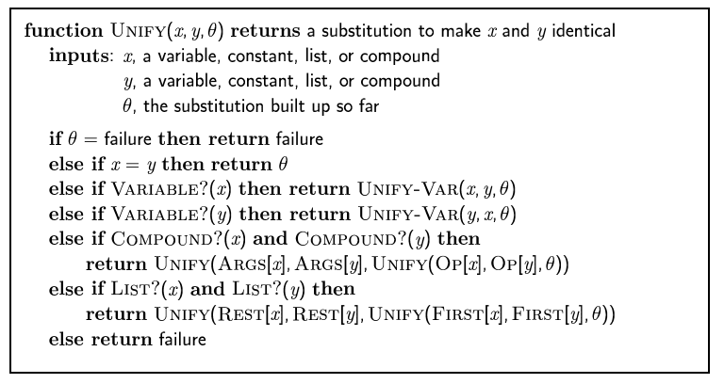
The unification algorithm
Notes:
‹#›

Slide 17
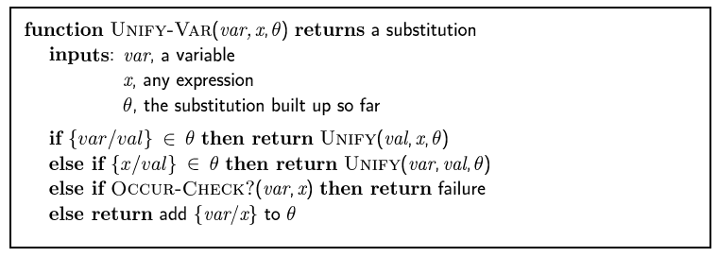
The unification algorithm
Notes:
‹#›

Slide 18
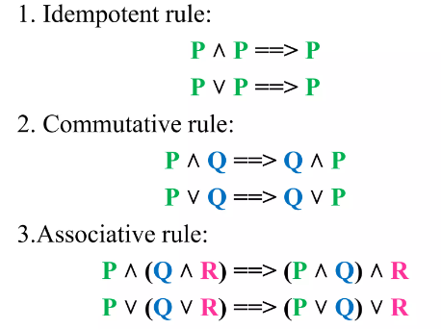
INFERENCE RULES
Notes:
‹#›

Slide 19
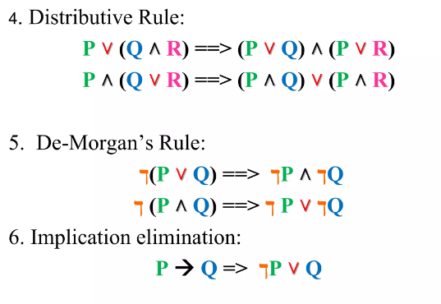
INFERENCE RULES
Notes:
‹#›

Slide 20
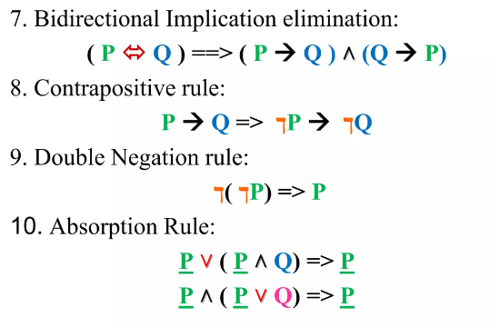
INFERENCE RULES
Notes:
‹#›

Slide 21
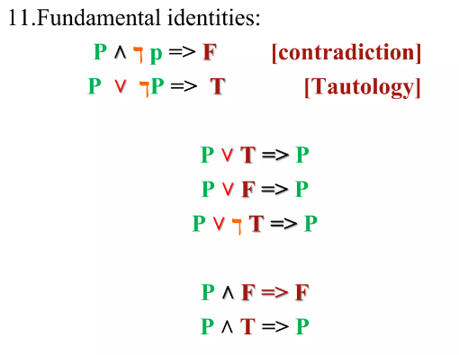
INFERENCE RULES
Notes:
‹#›

Slide 22
Resolution: brief summary
Full first-order version:
l₁ ∨ ··· ∨ l_{k}, m₁ ∨ ··· ∨ m_{n}
(l₁ ∨ ··· ∨ l_{i-1} ∨ l_{i+1} ∨ ··· ∨ l_{k} ∨ m₁ ∨ ··· ∨ m_{j-1} ∨ m_{j+1} ∨ ··· ∨ m_{n})θ
where Unify(l_{i}, ¬m_{j}) = θ.
The two clauses are assumed to be standardized apart so that they share no variables.
For example,
¬Rich(x) ∨ Unhappy(x)
Rich(Ken)
Unhappy(Ken)
with θ = {x/Ken}
Apply resolution steps to CNF(KB ∧ ¬α); complete for FOL
Notes:
‹#›

Slide 23
Conversion to CNF
Sentence:
Everyone who loves all animals is loved by someone.
∀x [∀y Animal(y) ⇒ Loves(x,y)] ⇒ [∃y Loves(y,x)]
Eliminate biconditionals and implications
∀x [¬∀y ¬Animal(y) ∨ Loves(x,y)] ∨ [∃y Loves(y,x)]
Move ¬ inwards: ¬∀x p ≡ ∃x ¬p, ¬ ∃x p ≡ ∀x ¬p
∀x [∃y ¬(¬Animal(y) ∨ Loves(x,y))] ∨ [∃y Loves(y,x)]
∀x [∃y ¬¬Animal(y) ∧ ¬Loves(x,y)] ∨ [∃y Loves(y,x)]
∀x [∃y Animal(y) ∧ ¬Loves(x,y)] ∨ [∃y Loves(y,x)]
Notes:
‹#›

Slide 24
Conversion to CNF contd.
Standardize variables: each quantifier should use a different one:
∀x [∃y Animal(y) ∧ ¬Loves(x,y)] ∨ [∃z Loves(z,x)]
Skolemize: a more general form of existential instantiation.Each existential variable is replaced by a Skolem function of the enclosing universally quantified variables:
∀x [Animal(F(x)) ∧ ¬Loves(x,F(x))] ∨ Loves(G(x),x)
Drop universal quantifiers:
[Animal(F(x)) ∧ ¬Loves(x,F(x))] ∨ Loves(G(x),x)
Distribute ∨ over ∧ :
[Animal(F(x)) ∨ Loves(G(x),x)] ∧ [¬Loves(x,F(x)) ∨ Loves(G(x),x)]
Notes:
‹#›

Slide 25
Resolution Procedure
Convert all the statements of F to clause form.
Negate P and convert the result to clause form. Add it to the set of clauses obtained in step 1.
Repeat until either a contradiction is found or no progress can be made
Select two clauses. Call these the parent clauses.
Resolve them together. The resolvent will be the disjunction of all the literals of both parent clauses with appropriate substitutions performed and with the following exceptions: If there is one pair of literals T1 and ¬T2 such that one of the parent clause contains T2 and the other contains t1 and if t1 and t2 are unifiable, then neither T1 nor T2 should appear in the resolvent. We call T1 and T2 as complementary literals. Use the substitution produced by the unificationto create the resolvent. If there is more than pair of complementary literals, only one pair should be omitted from the resolvent.
If the resolvent is the empty clause, then a contradiction has been found. If it is not, then add it to the set of clauses available to the procedure.

Slide 26
Resolution - Problem 1
All people who are graduating are happy.
All happy people smile.
Someone is graduating.
Conclusion: Is someone smiling?

Slide 27
Solution:
Step 1: Convert in to predicate Logic
∀ _{x} [graduating(x)🡪happy(x)
∀ _{x}(happy(x) 🡪 smile(x)
∃ _{x} graduating(x)
∃ _{x} smile(x)

Slide 28
Step 2: Convert to clausal form
(i) Eliminate the 🡪 sign
∀_{x} ⌐ graduating(x) ∨ happy(x)
∀ _{x} ⌐happy(x) ∨ smile(x)
∃ _{x} graduating(x)
⌐ ∃ _{x} smile(x)

Slide 29
(ii) Reduce the scope of negation
∀ _{x} ⌐ graduating(x) ∨ happy(x)
∀ _{x} ⌐ happy(x) ∨ smile(x)
∃ _{x} graduating(x)
∀ _{x} ⌐ smile(x)

Slide 30
(iii) Standardize variables apart
∀ _{x} ⌐ graduating(x) ∨ happy(x)
∀ _{x} ⌐ happy(x) ∨ smile(x)
∃ _{x} graduating(x)
∀ _{x} ⌐ smile(x)

Slide 31
(iv) Move all quantifiers to the left
∀ _{x} ⌐ graduating(x) ∨ happy(x)
∀ _{x} ⌐ happy(x) ∨ smile(x)
∃ _{x} graduating(x)
∀ _{x} ⌐ smile(x)

Slide 32
(v) Eliminate ∃
∀ _{x} ⌐ graduating(x) ∨ happy(x)
∀ _{x} ⌐ happy(x) ∨ smile(x)
graduating(name1)
∀ _{x} ⌐ smile(x)

Slide 33
(vi) Eliminate ∀
⌐ graduating(x) ∨ happy(x)
⌐ happy(x) ∨ smile(x)
graduating(name1)
⌐ smile(x)

Slide 34
Step 3:
Repeat until either a contradiction is found or no progress can be made
Select two clauses (one is negation of goal state and other any of the clauses obtained in Step 2. Call these the parent clauses.
Resolve them together and check if the resolvent is the empty clause, then a contradiction has been found. If it is not, then add it to the set of clauses available to the procedure.

Slide 35
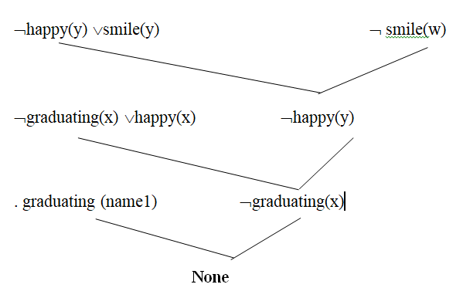
Resolution proof
Thus, we proved someone is smiling.

Slide 36
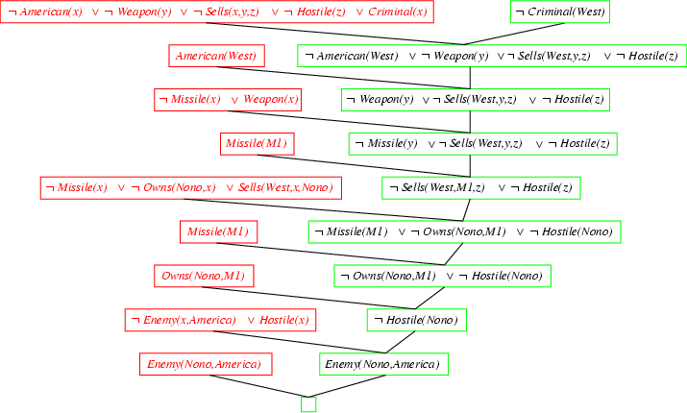
Resolution: Example problem 2
AI 1
Notes:
‹#›

